Slide 1



Simulated Shopping Cart
Atif Sididqui

Slide 2

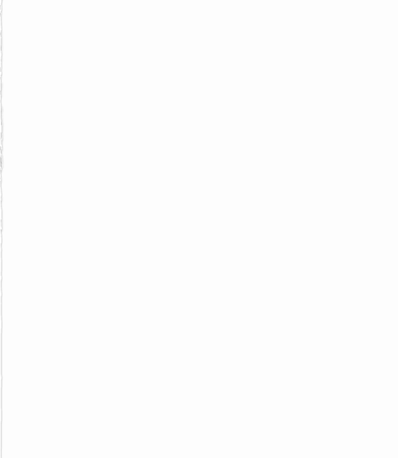
Presentation Breakdown
General Overview
User class and UserList
Products and Products Factory
ShoppingCart Singleton and Builder
Payment Processor and User Details
Testing
Demo

Slide 3
General feature Overview
Console Based shopping experience

